Slide 1
Information System
ITEC-522
5th Semester Third Year
Information Technology
Dr. Khalil-ur-Rahmen Khoumbati
Professor
Department of Information Technology
Faculty of Engineering and Technology
University of Sindh, Jamshoro
Khalil.khoumbati@gmail.com
Week-2

Slide 2
Information System - Elements
An information system (IS) collects, processes, stores, analyzes, and disseminates information for a specific purpose “Application”.
Application
Hardware
Hardware
Software
Data
Network
People
Software
Data
People

Slide 3
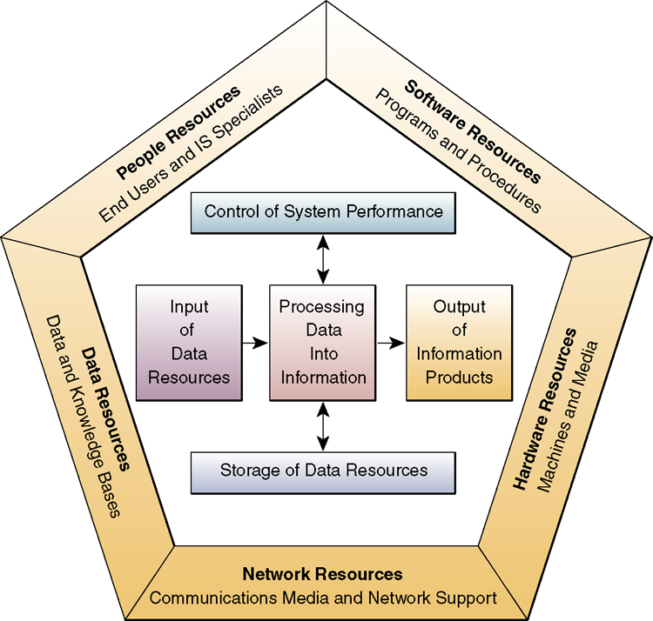
Cont.
Notes:
Introduction to Information Systems
Chapter 1
© 2002 McGraw-Hill Companies
The information system model shown on the slide highlights the relationships among the components and activities of information systems:
People Resources. People are required for operation of all ISs. People resources include:
End Users. As mentioned, these people use the IS or the information it produces.
IS Specialists. These people develop and operate the IS.
Hardware Resources. These include all the physical devices and materials used in information processing, including all machines and data media. Key components include:
Computer Systems. These are the CPUs and their related peripherals, such as terminals and networked PCs.
Computer Peripherals. These are input and output devices like keyboards, monitors, and secondary storage.
Telecommunications Networks. These are the computer systems interconnected by various telecommunications media such as modems.
Software Resources. These include all sets of information processing instructions. Software resources include:
System Software. This controls the computer.
Application Software. These are for a specific end user task, such as word-processing.
Procedures. These are the operating instructions for the people who use the IS.
Data Resources. Data is both the raw material of and among the most valuable organizational resources in the IS. Data can be in alphanumeric, text, image and/or audio form. Data are typically organized into either Databases - which hold processed and organized data; or Knowledge bases - which hold knowledge in a variety of forms such as facts and rules of inference about a given subject.

Slide 4
Cont.
The information system model shown on the slide highlights the relationships among the components and activities of information systems:
People Resources. People are required for operation of all ISs. People resources include:
  End Users. As mentioned, these people use the IS or the information it produces.
  IS Specialists. These people develop and operate the IS.
Hardware Resources. These include all the physical devices and materials used in information processing, including all machines and data media. Key components include:
  Computer Systems. These are the CPUs and their related peripherals, such as terminals and networked PCs.
  Computer Peripherals. These are input and output devices like keyboards, monitors, and secondary storage.
  Telecommunications Networks. These are the computer systems interconnected by various telecommunications media such as modems.

Slide 5
Cont.
Software Resources. These include all sets of information processing instructions. Software resources include:
  System Software. This controls the computer.
  Application Software. These are for a specific end user task, such as word-processing.
  Procedures. These are the operating instructions for the people who use the IS.
Data Resources. Data is both the raw material of and among the most valuable organizational resources in the IS. Data can be in alphanumeric, text, image and/or audio form. Data are typically organized into either Databases - which hold processed and organized data; or Knowledge bases - which hold knowledge in a variety of forms such as facts and rules of inference about a given subject.

Slide 6
Data versus Information
Data:
Data is the plural of datum, though data commonly represents both singular and plural forms.
Data are raw facts or observations, typically about physical phenomena or business transactions.
Data should be viewed as raw material resources that are processed into finished information products.
Data are usually subjected to a value-added process (data processing or information processing) where
  Its form is aggregated, manipulated, and organized
  Its content is analyzed and evaluated
  It is placed in a proper context for a human user.

Slide 7
Data versus Information
Information:
Information can be defined as data that have been converted into a meaningful and useful context for specific end users.
Information should be viewed as processed data which has been placed in a context that gives it value for specific end users.

Slide 8
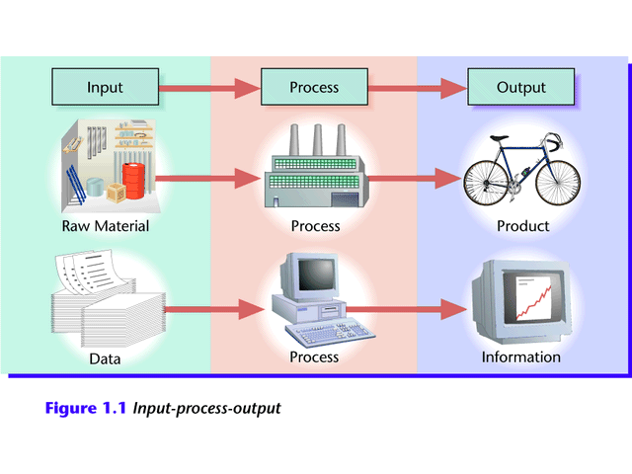
Cont.
Generating Information
  Computer-based ISs take data as raw material, process it, and produce information as output.

Slide 9



Cont.
Monthly Sales Report
for West Region
1200 100
West Charles Mann
79154 TM Shoes
Sales Rep: Charles Mann
Emp No. 79154
Item Qty Sold Price
TM Shoes 1200 $100
Notes:
Introduction to Information Systems
Chapter 1
© 2002 McGraw-Hill Companies
Data:
Data is the plural of datum, though data commonly represents both singular and plural forms.
Data are raw facts or observations, typically about physical phenomena or business transactions.
Data should be viewed as raw material resources that are processed into finished information products.
Data are usually subjected to a value-added process (data processing or information processing) where
Its form is aggregated, manipulated, and organized
Its content is analyzed and evaluated
It is placed in a proper context for a human user
Information:
Information can be defined as data that have been converted into a meaningful and useful context for specific end users.
Information should be viewed as processed data which has been placed in a context that gives it value for specific end users.

Slide 10
Activities in an IS
INPUT
PROCESS
OUTPUT
FEEDBACK

Slide 11
History of the of information systems
1950-1960
1960-1970
1970-1980
1980-1990
1990-2000
Data
Processing
Management
Reporting
Decision
Support
Strategic &
End User
Electronic
Commerce
Electronic
Data
Processing
- TPS
Management
Information
Systems
Decision
Support
Systems
- Ad hoc
Reports
End User
Computing
Exec Info Sys
Expert Systems
Electronic
Business &
Commerce
-Internetworked
E-Business &
Commerce
Notes:
Introduction to Information Systems
Chapter 1
© 2002 McGraw-Hill Companies
Data Processing: 1950s - 1960’s:
Electronic data processing systems. Transaction processing, record-keeping, and traditional accounting applications
Management Reporting: 1960s - 1970’s:
Management Information systems. Management reports of prespecified information to support decision making.
Decision Support: 1970s - 1980s:
Decision Support systems. Interactive ad hoc support of the managerial decision-making process.
Strategic and End User Support: 1980s - 1990’s:
End User computing systems. Direct computing support for end user productivity and work group collaboration.
Executive information systems. Critical information for top management
Expert systems: Knowledge-based expert advice for end users
Strategic Information Systems. Strategic products and services for competitive advantage
Electronic Business and Commerce: 1990’s - 2000’s:
Internetworked e-business and e-commerce Systems. Internetworked enterprise and global e-business operations and e-commerce on the Internet, intranets, extranets, and other networks.

Slide 12
Cont.
Data Processing: 1950s - 1960’s:
Electronic data processing systems. Transaction processing, record-keeping, and traditional accounting applications
Management Reporting: 1960s - 1970’s:
Management Information systems. Management reports of prespecified information to support decision making.
Notes:
2

Slide 13
Cont.
Decision Support: 1970s - 1980s:
Decision Support systems. Interactive ad hoc support of the managerial decision-making process.
Strategic and End User Support: 1980s - 1990’s:
End User computing systems. Direct computing support for end user productivity and work group collaboration.
Notes:
2

Slide 14
Cont.
Electronic Business and Commerce: 1990’s - 2000’s:
Internetworked e-business and e-commerce Systems. Internetworked enterprise and global e-business operations and e-commerce on the Internet, intranets, extranets, and other networks.
Notes:
2

Slide 15
The Role of Information Systems in Business Today
How information systems are transforming business
  Increase in wireless technology use, Web sites
  Shifts in media and advertising
  New federal security and accounting laws
Globalization opportunities
  Internet has drastically reduced costs of operating on global scale
  Presents both challenges and opportunities
Notes:
New federal security and accounting laws that require companies to store e-mail for 5 years have spurred the growth of digital information, which is increasing at a rate of 5 exabytes annually. Students may be surprised to learn that 5 exabytes of data is equivalent to 37,000 Libraries of Congress. Ask the students to think about what difference it makes to the world economy, or the U.S. economy, if global operations become much less expensive? What are the challenges to American suppliers of goods and services, and to labor?

Slide 16
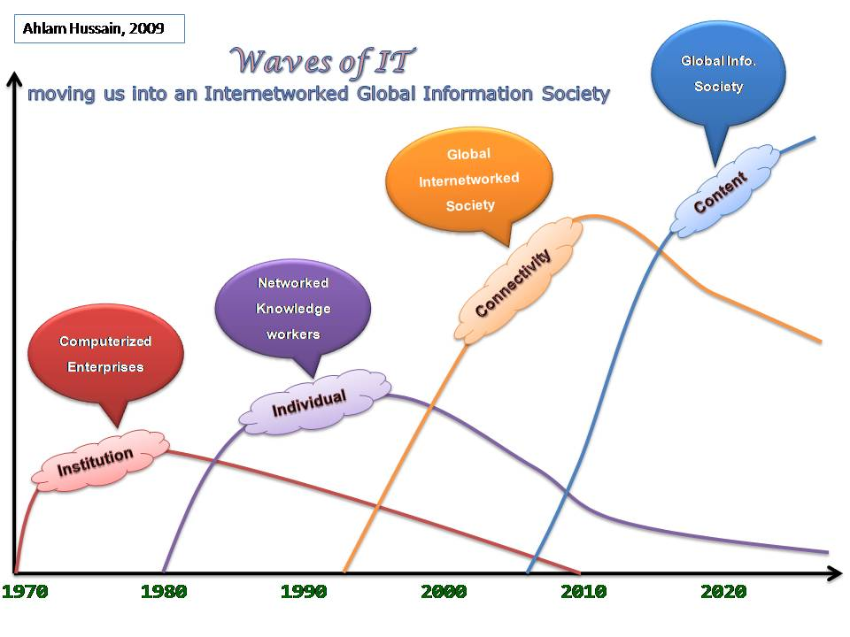

Slide 17
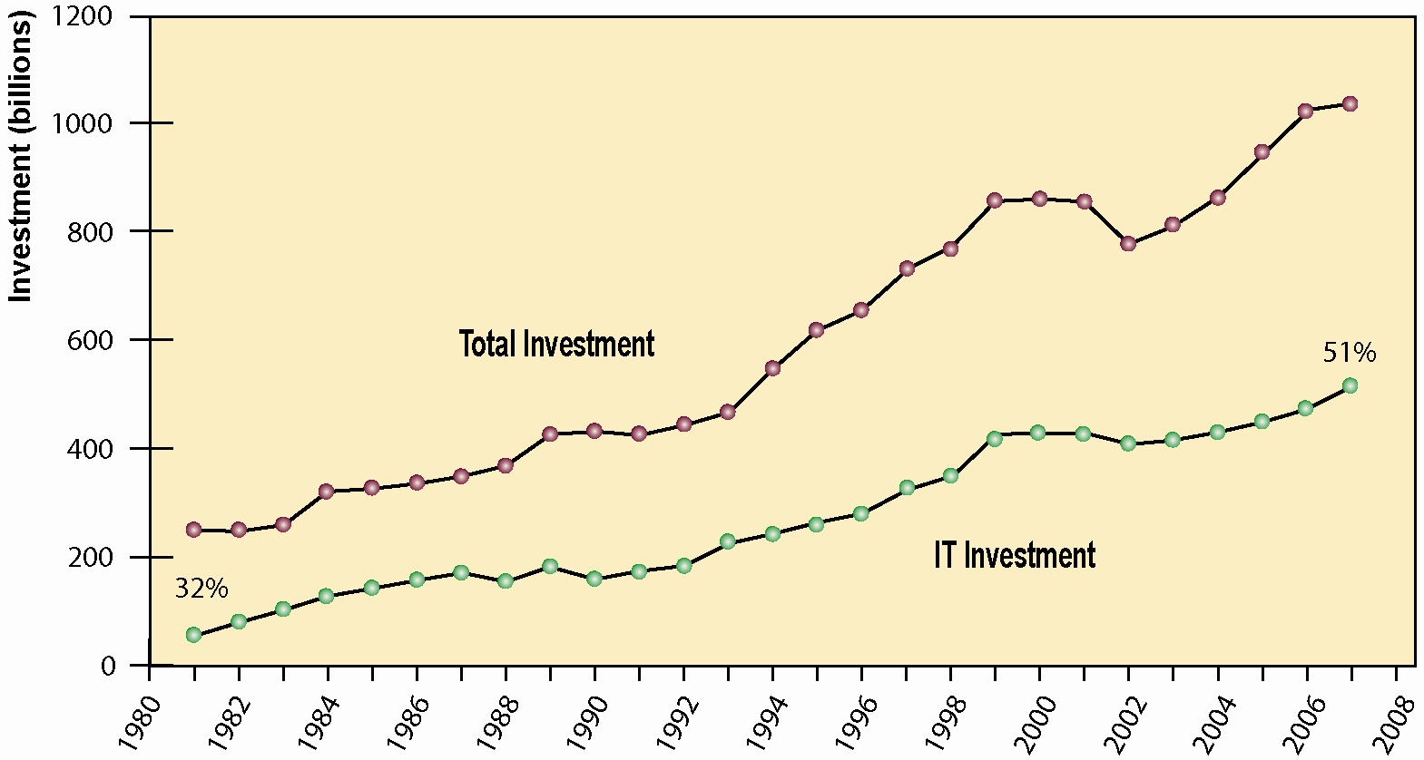
The Role of Information Systems in Business Today
Information Technology Capital Investment
Information technology investment, defined as hardware, software, and communications equipment, grew from 32% to 51% between 1980 and 2008.
Source: Based on data in U.S. Department of Commerce, Bureau of Economic Analysis, National Income and Product Accounts, 2008.
Figure 1-1
Notes:
Emphasize to students that total investment reached one trillion dollars in 2008, and that over 500 billion dollars of that was invested in information technology. You could ask them why it is that the percentage of total investment devoted to IT has increased so much since 1980? Other kinds of capital investment are machinery and buildings. Why would firms increase IT investment faster than machinery and buildings. The answer is capital substitution: the price of IT capital has been falling exponentially, while the price of machine and buildings has been growing at slightly more than the rate of inflation. Wherever possible, firms would much rather invest in more IT than machinery or buildings because the returns on the investment are greater. Why not invest in telework IT systems rather than building an expensive new office tower?

Slide 18
The Role of Information Systems in Business Today
In the emerging, fully digital firm
  Significant business relationships are digitally enabled and mediated
  Core business processes are accomplished through digital networks
  Key corporate assets are managed digitally
Digital firms offer greater flexibility in organization and management
  Time shifting, space shifting
Notes:
Time shifting and space shifting are connected to globalization. You could ask students to explain why a digital firm is more likely to benefit from globalization than a traditional firm; the right idea is that by allowing business to be conducted at any time (time shifting) and any place (space shifting), digital firms are ideally suited for global operations which take place in remote locations and very different time zones.

Slide 19
The Role of Information Systems in Business Today
Virtual Meetings: Smart Management
Read the Interactive Session and then discuss the following questions:
  What are the advantages of using videoconferencing technologies? What are the disadvantages?
  What is telepresence and what sorts of companies are best suited to use it as a communications tool?
  What kinds of companies could benefit from using videoconferencing? Are there any companies that might not derive any benefits from this technology?
Notes:
You could ask students if they’ve ever used any form of videoconferencing or video chat and whether or not they thought it was useful or effective. You could also ask students to describe the impact of videoconferencing on areas other than the businesses using it, such as the airline industry (negative impact due to reduction in airline travel) or the environment (positive impact). Ask students if they have used Web-based conferencing on their PC to connect with family members or friends. Do they think video conferencing on cell phones would be useful to business?

Slide 20
The Role of Information Systems in Business Today
Growing interdependence between ability to use information technology and ability to implement corporate strategies and achieve corporate goals
Business firms invest heavily in information systems to achieve six strategic business objectives: IT Strategic Role
  Operational excellence
  New products, services, and business models
  Customer and supplier intimacy
  Improved decision making
  Competitive advantage
  Survival
Notes:
In the NBA opening case, the UPS Interactive Session later in the chapter, and with many of the Interactive Sessions and opening cases in the book, it will be useful to ask students to explain how various information systems succeeded or failed in achieving the six strategic business objectives. For example, in the NBA case, information systems helped the Mavericks improve decision making and gave them a competitive advantage over teams that were not using the Synergy system.
You might ask the students to think about some other business objectives and think about how IT might help firms achieve them. For instance, speed to market is very important to firms introducing new products. How can IT help achieve that objective?

Slide 21
Operational excellence:
  Improvement of efficiency to attain higher profitability
  Information systems, technology an important tool in achieving greater efficiency and productivity
  Wal-Mart’s RetailLink system links suppliers to stores for superior replenishment system
Notes:
Wal-Mart is the most efficient retailer in the industry and exemplifies operational excellence. You could ask students to name other businesses that they believe to exhibit a high level of operational excellence. Do customers perceive operational excellence? Does it make a difference for customer purchasing? What Web sites strike students as really excellent in terms of customer service? If you have a podium computer, you might want to visit the Wal-Mart site and the Amazon site to compare them in terms of ease of use.

Slide 22
The Role of Information Systems in Business Today
New products, services, and business models:
  Business model: describes how company produces, delivers, and sells product or service to create wealth
  Information systems and technology a major enabling tool for new products, services, business models
    Examples: Apple’s iPod, iTunes, and iPhone, Netflix’s Internet-based DVD rentals
Notes:
You could ask students to name other new products or business models that they’ve encountered and how they might relate to new information systems or new technology. One way to encourage participation is ask students to help you list on the blackboard some really interesting recent digital product innovations. Discussing “green technologies” like wind, solar, and hybrid vehicles is always fun. In this context, what role will IT be playing in the development of these technologies?

Slide 23
Customer and supplier intimacy:
  Serving customers well leads to customers returning, which raises revenues and profits
    Example: High-end hotels that use computers to track customer preferences and use to monitor and customize environment
  Intimacy with suppliers allows them to provide vital inputs, which lowers costs
    Example: J.C.Penney’s information system which links sales records to contract manufacturer
Notes:
You could ask students what types of companies might rely more on customer and supplier intimacy more than others and which companies they feel have served them exceptionally well. Ask the students to identify online sites that achieve a high degree of customer intimacy. Sites to visit would include NetFlix, Amazon, and other sites which have recommender systems to suggest purchase ideas to consumers.

Slide 24
Improved decision making
  Without accurate information:
    Managers must use forecasts, best guesses, luck
    Leads to:
      Overproduction, underproduction of goods and services
      Misallocation of resources
      Poor response times
    Poor outcomes raise costs, lose customers
  Example: Verizon’s Web-based digital dashboard to provide managers with real-time data on customer complaints, network performance, line outages, etc.
Notes:
You could ask students if they have ever been recipients of exceptional service from a company made possible by improved decision-making and whether or not information systems contributed to that level of service. For example, perhaps they had a power outage and it took a very short (or very long) time for the company to correct the error.

Slide 25
Operational excellence:
  Improvement of efficiency to attain higher profitability
New products, services, and business models:
  Enabled by technology
Customer and supplier intimacy:
  Serving customers raises revenues and profits
  Better communication with suppliers lowers costs
Improved decision making
  More accurate data leads to better decisions
Notes:
This slide is a recap of the previous four slides. You might ask students which business objective they believe to be most critical to the success of a business, or whether they all carry equal weight.

Slide 26
Competitive advantage
  Delivering better performance
  Charging less for superior products
  Responding to customers and suppliers in real time
  Example: Toyota and TPS (Toyota Production System) enjoy a considerable advantage over competitors – information systems are critical to the implementation of TPS
Notes:
Emphasize that achieving any of the previous four business objectives represents the achievement of a competitive advantage as well.

Slide 27
Survival
  Information technologies as necessity of business
  May be:
    Industry-level changes, e.g. Citibank’s introduction of ATMs
    Governmental regulations requiring record-keeping
      Examples: Toxic Substances Control Act, Sarbanes-Oxley Act
Notes:
Ask students if they can name any examples of companies that failed to survive due to unwillingness or inability to update their information systems. The Sarbanes-Oxley Act requires that public firms keep all data, including e-mail, on record for 5 years. You could ask students if they appreciate why information systems would be useful towards meeting the standards imposed by this legislation.

Slide 28
Cont.
Today forward:
The increase in internet bandwidth over recent years has led to a substantial reliance on cloud computing, Internet of things and block chain technology.
Today, practically any employee is now in a position to make informed decisions with tools that are readily available across multiple platforms.
Notes:
2

Slide 29
Discussion
Questions?

